Slide 1

Wael Hamze Jordi Montaña Vázquez
TDD/DevOps for Dynamics 365 CE

Slide 2



Wael Hamze
CRM / DevOps Lead
@WaelHamze http://www.linkedin.com/in/waelhamze

Slide 3


Jordi Montaña Vázquez
CRM Solution Architect
Founder at DynamicsValue
@jordimontana http://www.linkedin.com/in/jordimontana

Slide 4


Slide 5


What is DevOps/CI/CD?
DEV
QA
Ops
Fast
DevOps
Plan
Code
Build
Test
Release
Deploy
Monitor
Feedback
Continuous Business
Value
Automation

Slide 6
Workshop Scenario?
https://github.com/DynamicsValue/365saturday
https://code.visualstudio.com/download
https://www.visualstudio.com/vso/

Slide 7
Test Automation
Unit Testing
Integration Testing
UI Testing
CRM Env. (QA)
Unit Testing
Integration Testing
UI Testing
System Tests
Trigger from Build
Visual Studio / Build

Slide 8
Unit Testing in Dynamics CE
.NET (plugins, codeactivities, external apps)
Javascript (Web API, Form logic, Web resources)
.NET
Unit Testing
Javascript

Slide 9
Unit Testing for Dynamics CE
.NET (FakeXrmEasy on NuGet)
Javascript (fakexrmeasy on npm)
.NET
FakeXrmEasy (NuGet)
Unit Testing
fakexrmeasy (npm)
Javascript
xrm-mock (npm)

Slide 10
FakeXrmEasy Architecture Overview
CRM LINQ
QueryByAttribute
FetchXml
QueryExpression
LINQ
In-Memory DB (Dictionaries)

Slide 11
fakexrmeasy Architecture Overview (II)
XmlHttpRequest mock
OData Query
fakexrmeasy (npm)
Edge.js
FakeXrmEasy (C#)
EdgeProxy
QueryExpression
LINQ
FakeXrmEasy.EdgeProxy
In-Memory DB

Slide 12
Continuous Integration Setup
Configure
CRM Dev
Export
Developer
Check-In
Export
Source Control
Test Automation
Trigger Build
Build Automation
Test
Pull sources
Store Artifacts
Artifact Repository

Slide 13





VSTS/TFS Automation
Manual Scheduled
Build
Hosted Agent
Trigger Job
Poll
Build/ Release Def.
Queue
VSTS/TFS
Configure
Create
Put
Developer
Store
Poll
Own Agent
Job Definitions

Slide 14

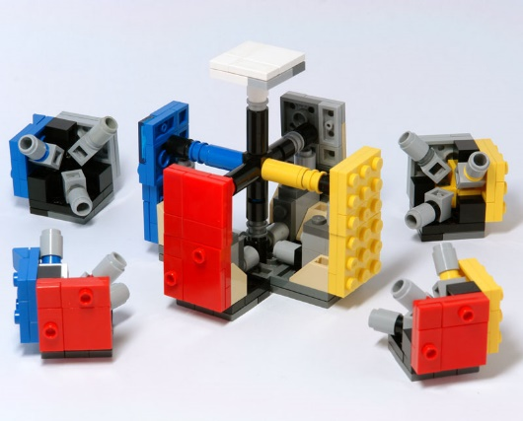
Solution Packager
Command Line Utility from CRM SDK
Unpack a CRM Solution zip into multiple files
The files can be managed by source control
Pack files source control into a CRM Solution zip
SolutionPackager.exe /action:Extract /zipfile:“CRMUG.zip" /folder:"SolutionFiles" /packagetype:Both /map:”Mapping.xml”
SolutionPackager.exe /action:Pack /folder:"SolutionFiles" /zipfile:“CRMUG.zip" /packagetype:Both /map:”Mapping.xml”

Slide 15
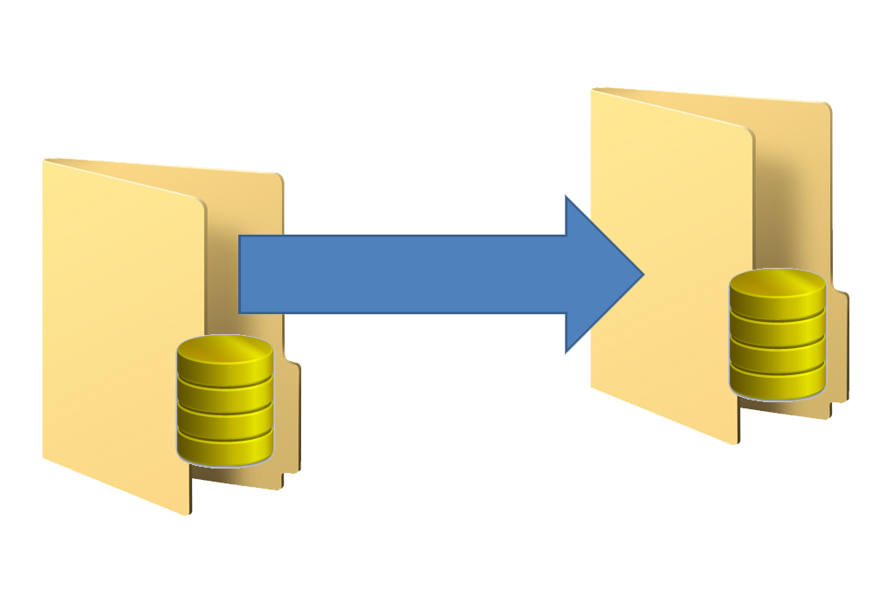
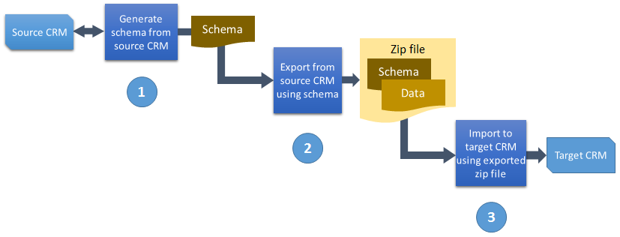
Configuration Migration Tool
Define Schema (Entities, Attributes, Relationships, Matching)
Export Data
Import Data

Slide 16
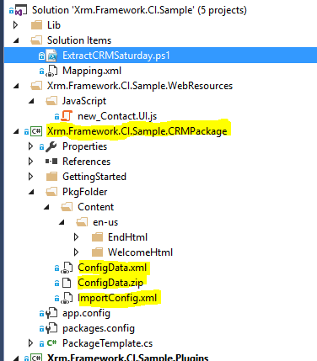
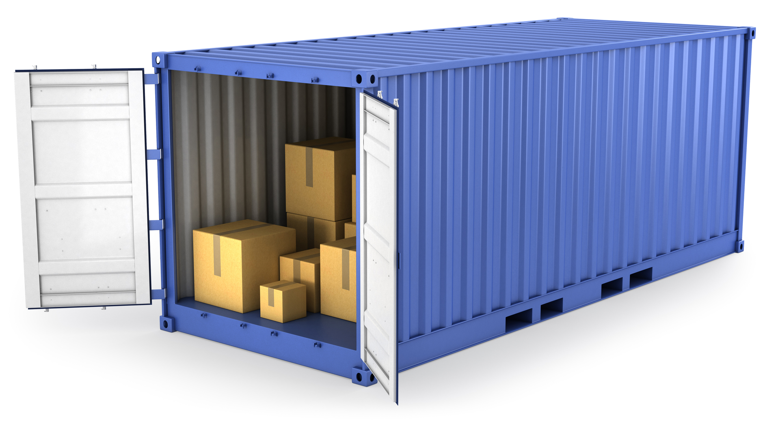

CRM Package
Visual Studio Template: CRM Solution
Configuration data files
Execute Custom Code
Deployed using:
Package Deployer
PowerShell

Slide 17
Dynamics 365/CRM Build Process
Sources
Source Control
Build Definition
Compile
Artifacts
CRM Solutions
Version
Code Analysis
Unit Tests
CRM Packages
Configuration
Data
Scripts
ETL Packages
Tests
CRM Environments
Sign
Other
Export
Package

Slide 18
Continuous Delivery Pipeline
Configure
CRM Dev
CRM Stage
Export
Developer
Check-In
Export
Promote
Source Control
Test Automation
Trigger Build
Build Automation
Test
CRM Env.
Pull sources
QA
Store Artifacts
Test
Trigger Deployment
Promote
Artifact Repository
Deployment Automation
CRM Prod
Use
Deploy
Use
User
Ops

Slide 19
Dynamics 365/CRM Release Process
Artifacts
CRM Solutions (Base)
CRM Packages (CRMDemo, Data)
Configuration
Data
Scripts
ETL Packages
Services/Portal
Tests (Unit/Integration)
Release Def.
Approvals
Notifications
Backup / Restore
Infra/Env. Setup
Import Solutions (Base)
Install Packages (CRMDemo, Data)
Import Data
Run Tests (Integration Tests)
Environments
Stage
QA
SIT
UAT/OAT
Prod/DR
Use
Deploy

